Slide 1
From real world to exponential function

Slide 2
Observe two natural phenomena through ‘mathematical eyes’
Bacterial growth through binary fission.
  Radioactive decay of radiocarbon.

Slide 3
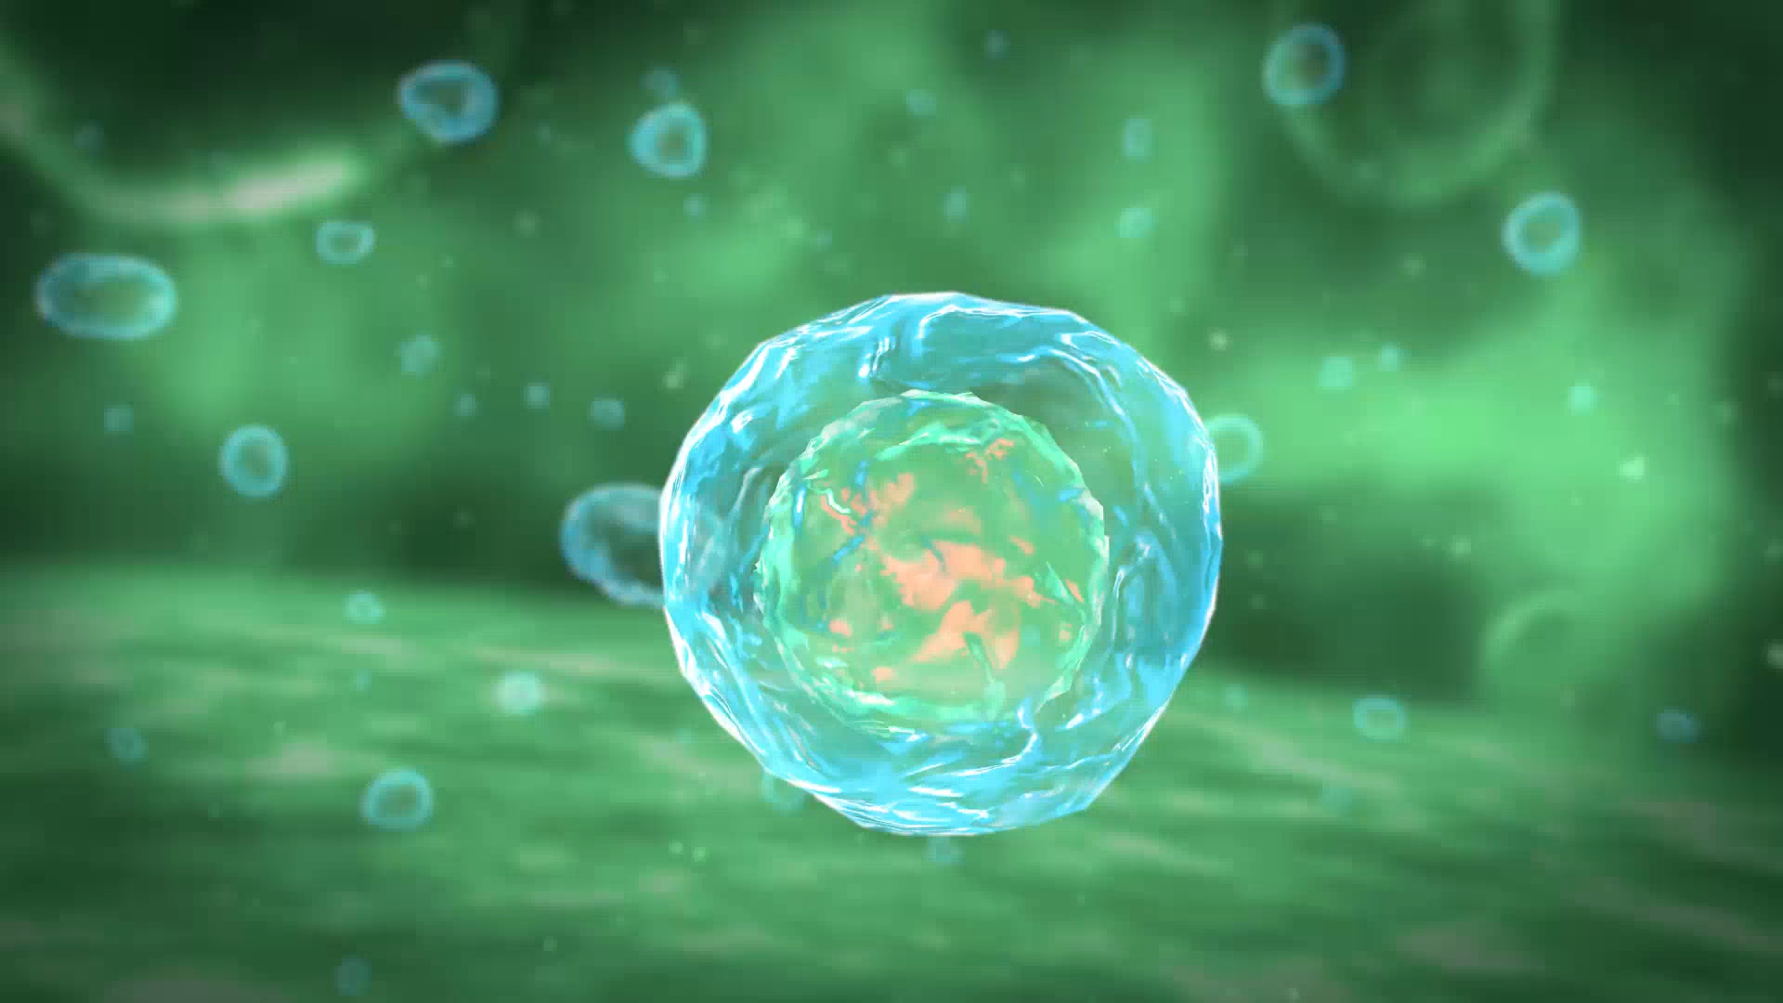
Bacterial reproduction
To reproduce, a bacterium repeatedly splits into two, as shown in the video

Slide 4
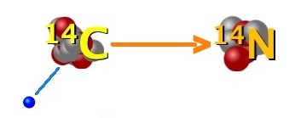
Radioactive decay of radiocarbon
Carbon-14 (¹⁴C) is a radioactive isotope of carbon that occurs naturally.
¹⁴C gradually decays, transforming into nitrogen-14 (¹⁴N).
Approximately half of the ¹⁴C atoms decay into ¹⁴N in about 6,000 years (half-life).
The following video illustrates a simulation of this process

Slide 5

Radioactive decay of radiocarbon
Simulation

Slide 6
Activity.
From real world to exponential law
Complete the worksheet to analyze the two processes through ‘mathematical eyes’.

Slide 7
What did you find?
Mathematical law describing bacterial growth
Mathematical law describing radioactive decay
Let's review some key stages of the path you have followed

Slide 8
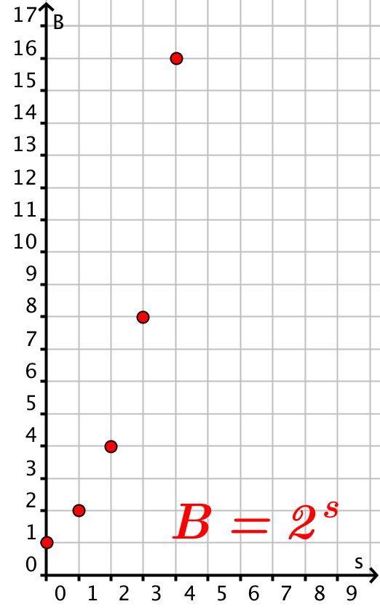
1. Bacterial reproduction law
Number of splits s | Number of bacteria B
0 | 1
1 | 2
2 | 4 = 2²
3 | 8 = 2³
10 | 2¹⁰
B = 2^{s}
I cannot think of −2 splits or 4.5 bacteria.
I can replace s only with any natural number.
The values of B are natural numbers (excluding 0)

Slide 9
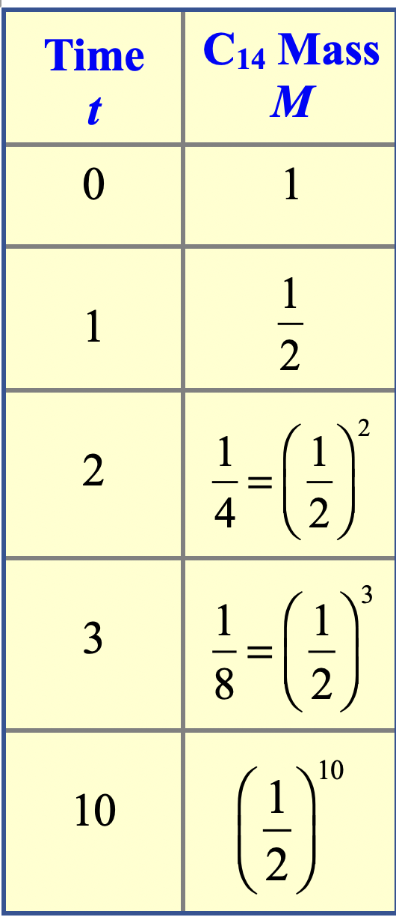
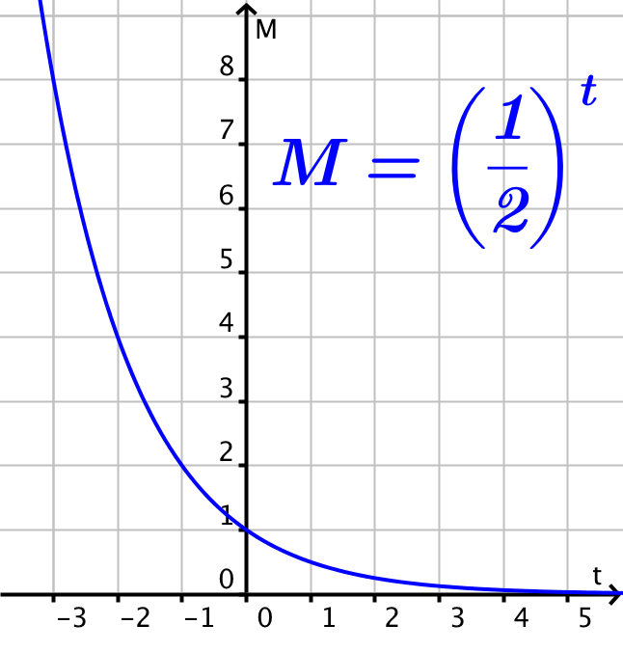
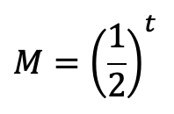
2. Radioactive decay law
I can think of the past as ‘negative time’, but I cannot have a negative mass of carbon-14

Slide 10
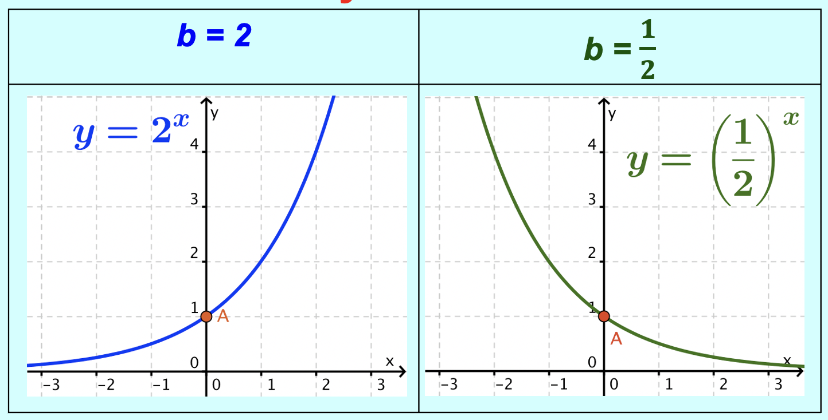
The exponential function
These natural phenomena help explain why the exponential function appears in mathematics.
Exponential function
y = b^{x}
Where b is a positive real number, x is a real variable, y is a real positive variable.

